Slide 1

Food
Is Fuel
Grades 4–6
Together For Health

Slide 2
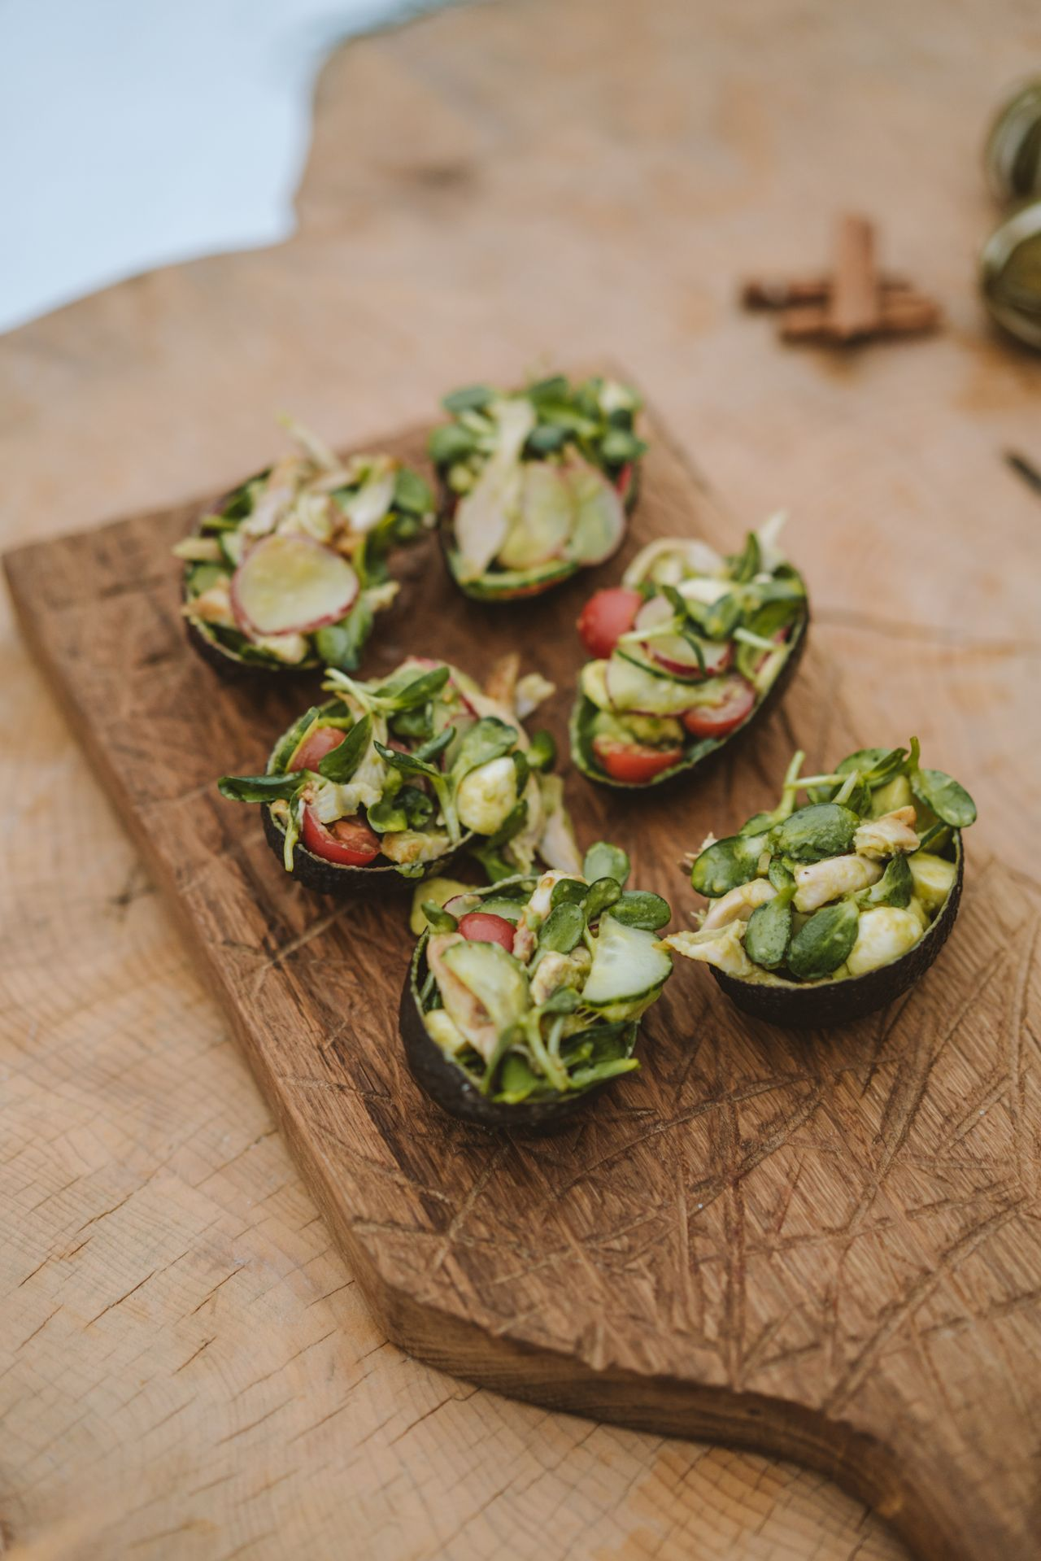
🥗
Food Is Your Fuel
Your brain uses 20% of all the energy your body gets from food.
What you eat directly affects how well you can think, focus, and feel throughout the day.
Together For Health

Slide 3
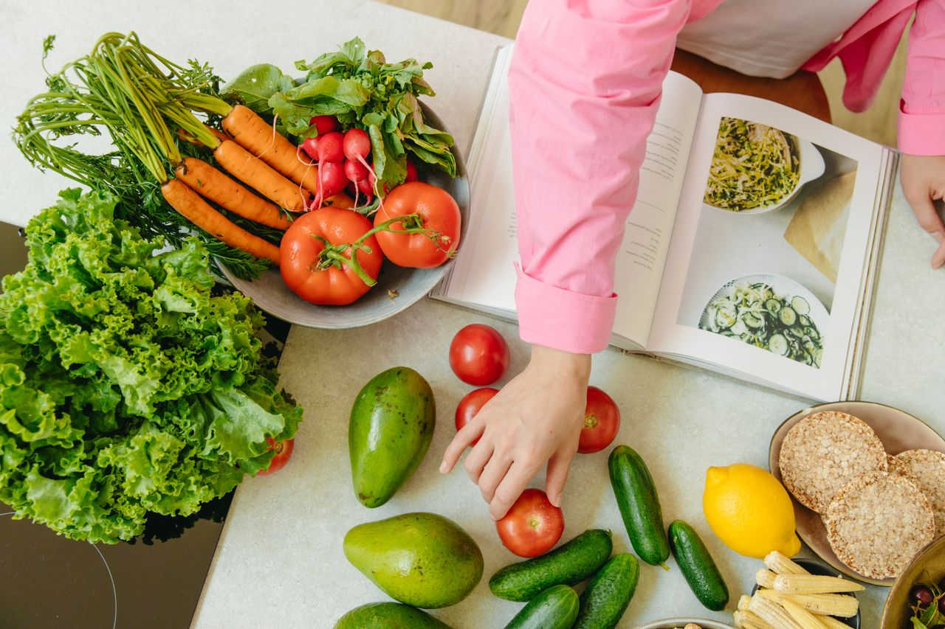
🌈
The Rainbow Rule — Eat the Colours
Red: tomatoes, strawberries — fight disease
Orange: carrots, oranges — build strong eyes and skin
Green: spinach, broccoli — protect your heart
Blue/Purple: blueberries, grapes — boost brain health
White/Brown: whole grains, potatoes — give you energy
Together For Health

Slide 4
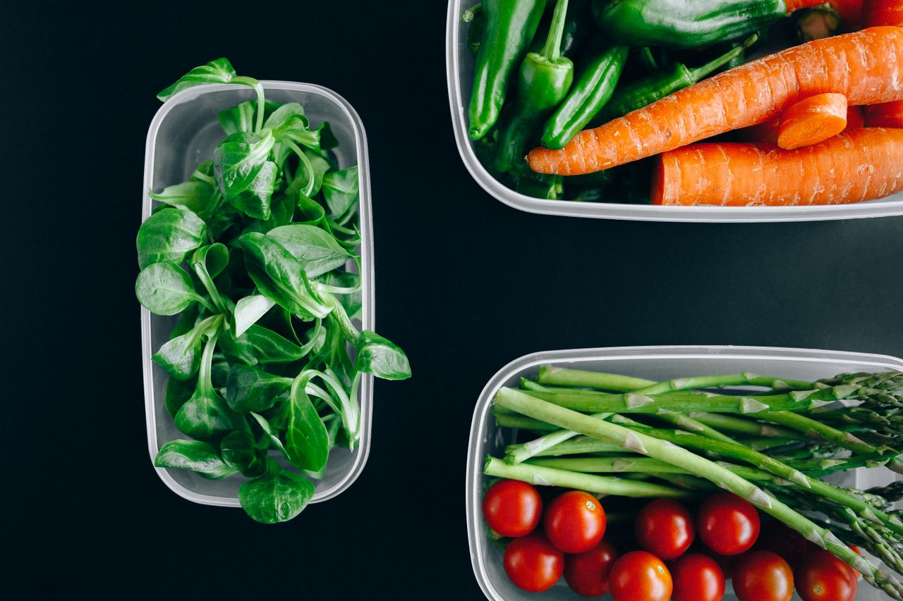
💧
The Basics of Healthy Eating
Drink 6–8 glasses of water every day
Eat breakfast — it powers your brain for learning
Fill half your plate with fruits and vegetables
Choose whole grains over white bread and pasta
Limit ultra-processed snacks, fast food, and sugary drinks
Together For Health

Slide 5

🍽️
Building a Healthy Meal
Start with vegetables — fill half your plate
1
Add protein: chicken, fish, eggs, beans, tofu
2
Include whole grains: brown rice, whole wheat bread
3
Add healthy fats: avocado, olive oil, nuts
4
Drink water with every meal
5
Together For Health

Slide 6
KEY TAKEAWAYS
Healthy food = better focus, energy, and mood
✓
Small changes add up — one good choice at a time
✓
You deserve food that makes you feel good
✓
Resources
Canada Food Guide: food-guide.canada.ca
Talk to a school nutritionist or doctor
Try cooking one healthy meal this week!
Together For Health

